Slide 1


Households with complex needs in Cheshire and Merseyside

Slide 2
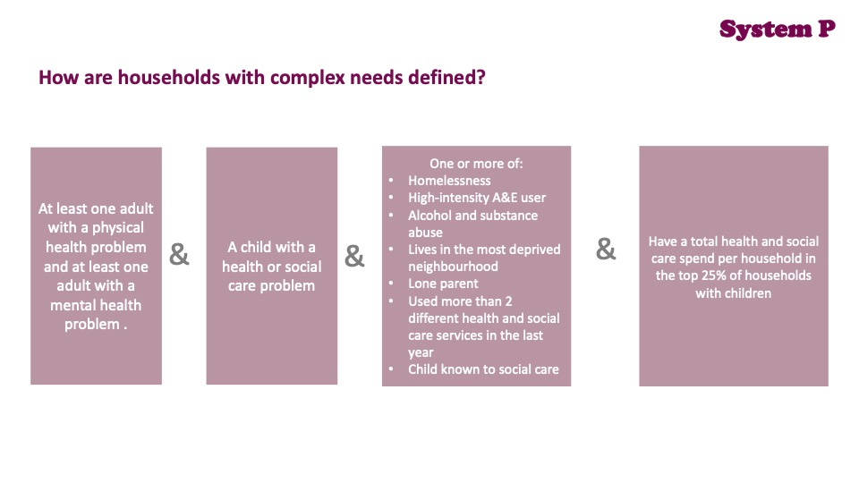

Slide 3
Summary:
This analysis is based on the data of 2,645,329 individuals registered in 2021 with a GP in Cheshire and Merseyside having a data sharing agreement in place with NHS Cheshire and Merseyside. This amounts to 97% of the registered population. We found that 1,022,840 individual people lived in a household with at least one child aged 0-16.
There were 267,320 households with children, of which 20,855 had complex needs. These households with complex needs included 86,423 people ( 39,846 children and 46,577 adults). This 8 % of families accounted for 34 % of health and social care costs for families with children. This was £ 315 million in total.

Slide 4
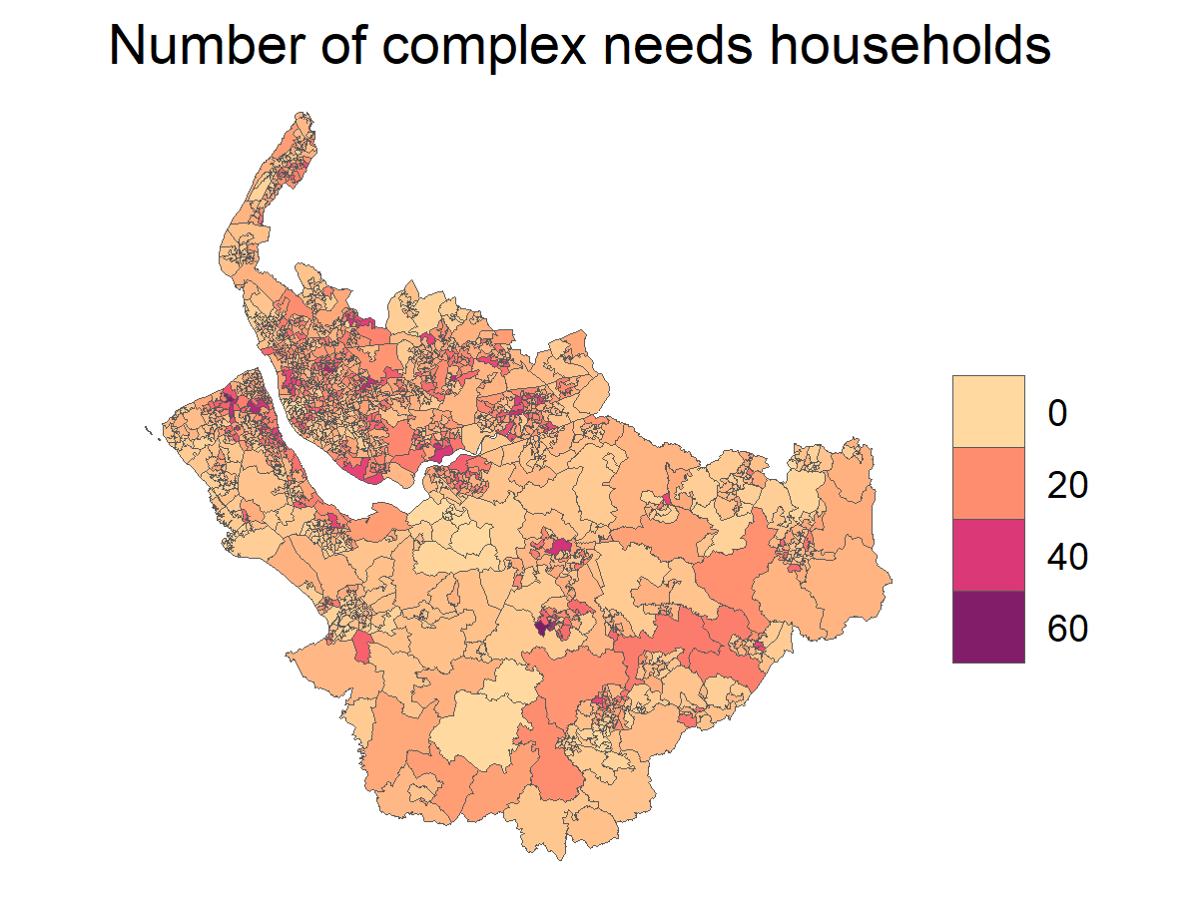
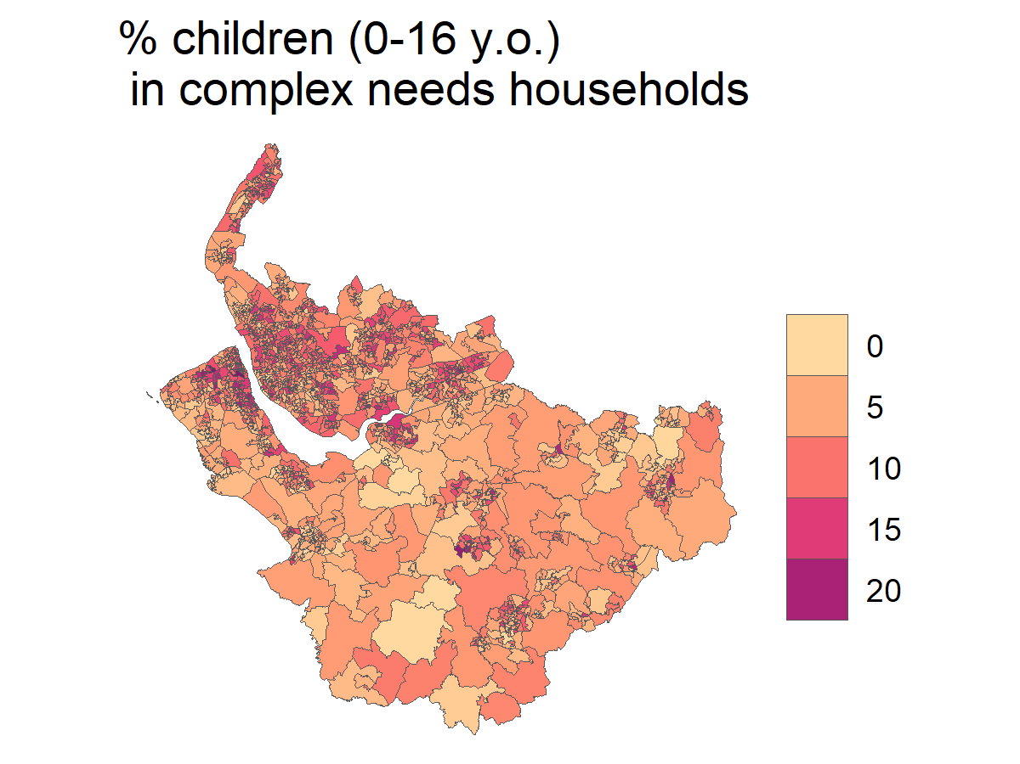
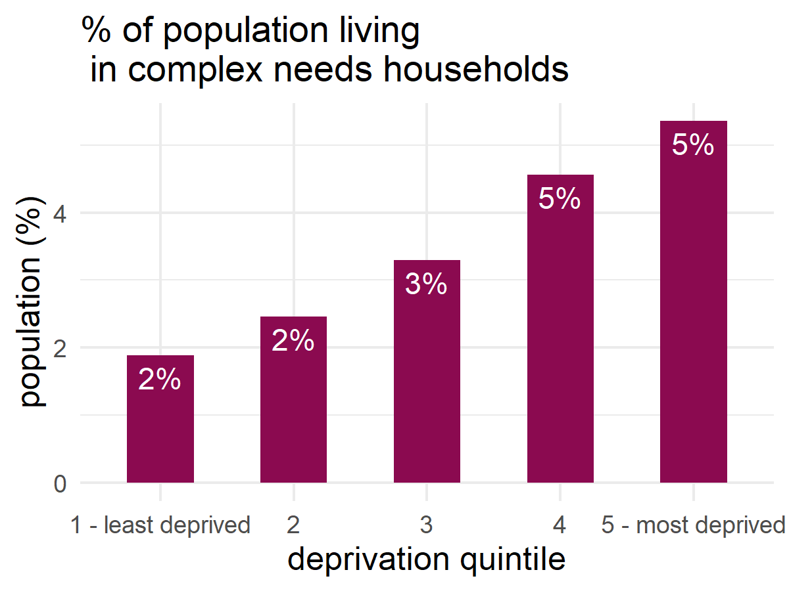
Geography and deprivation

Slide 5
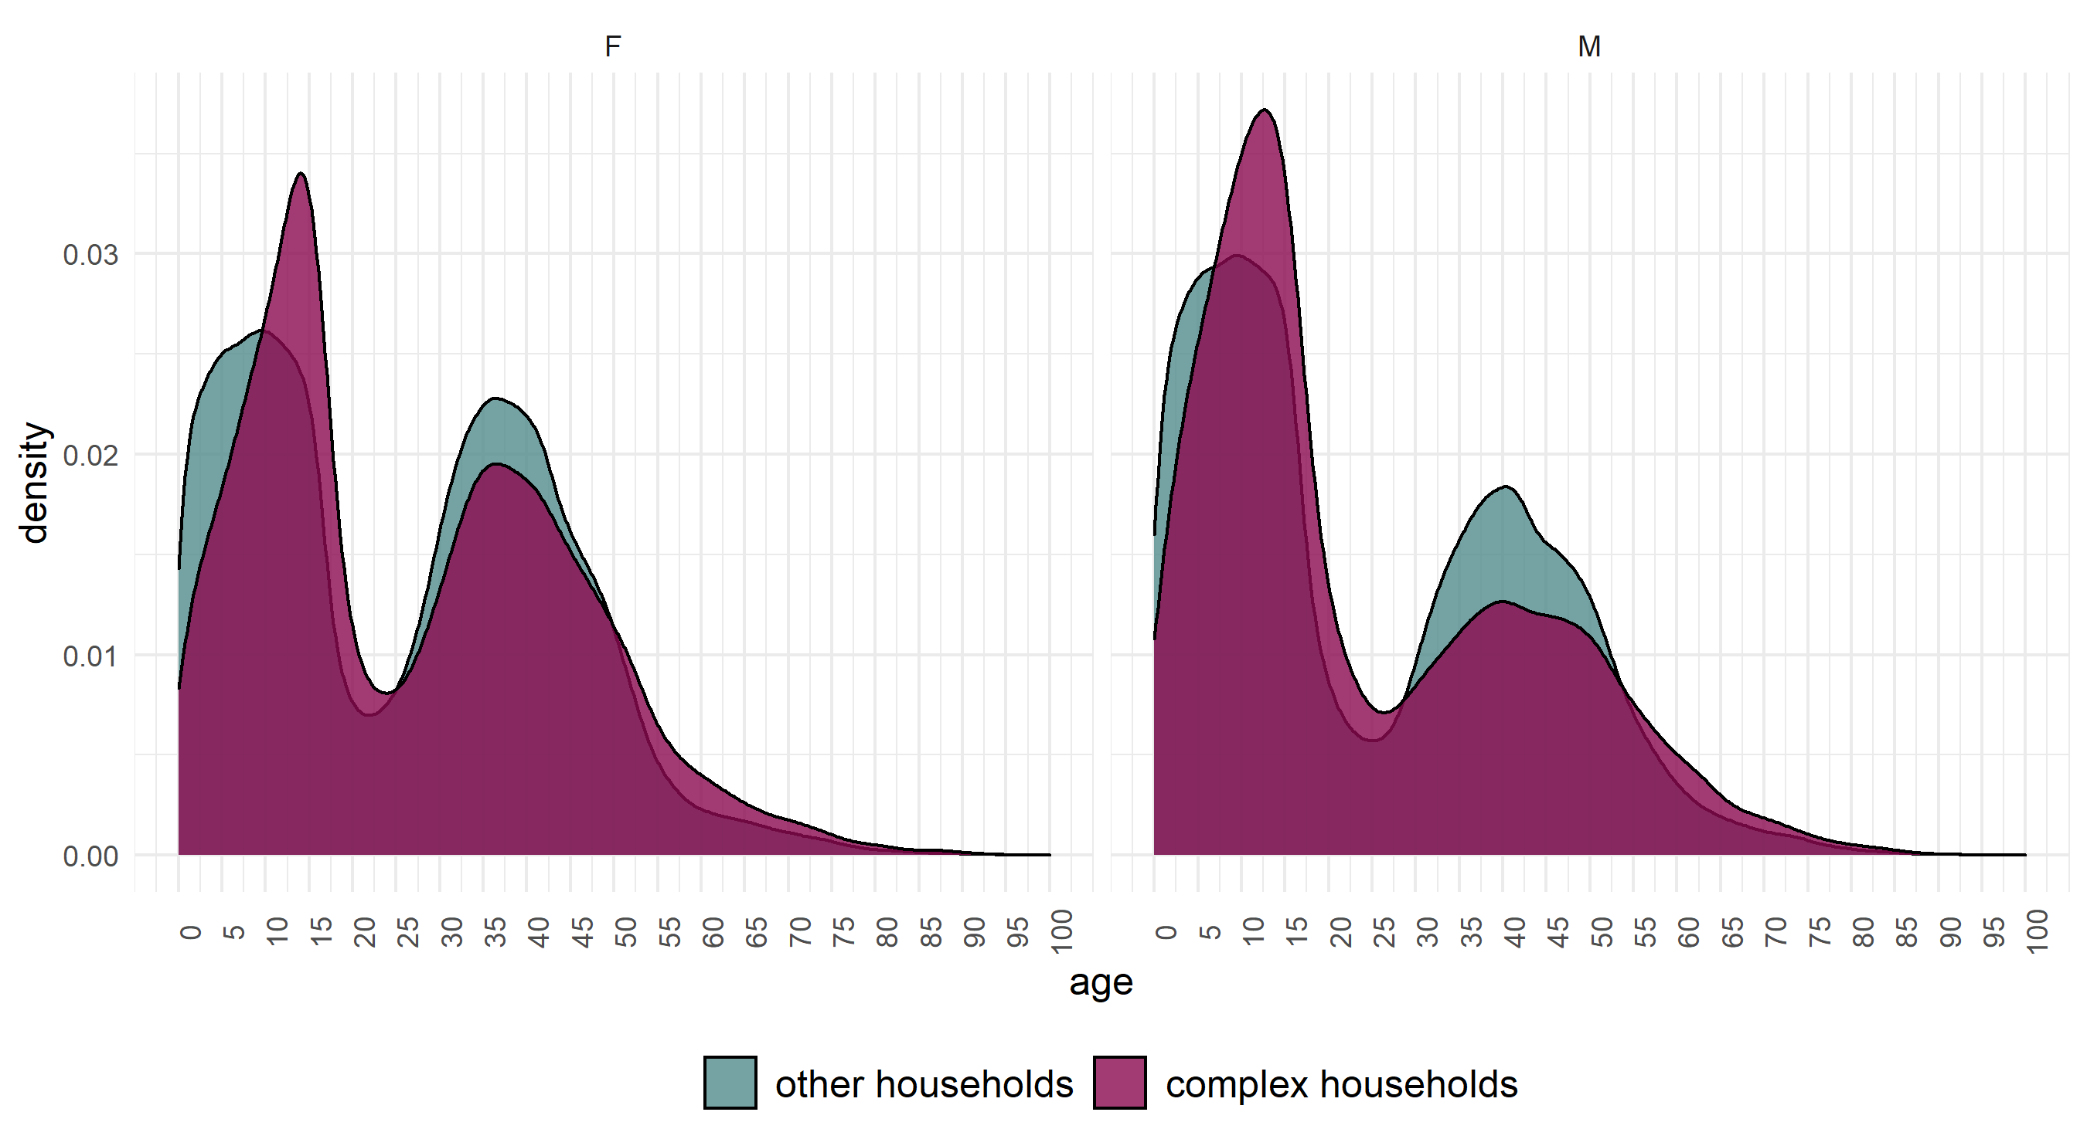
Age and gender

Slide 6
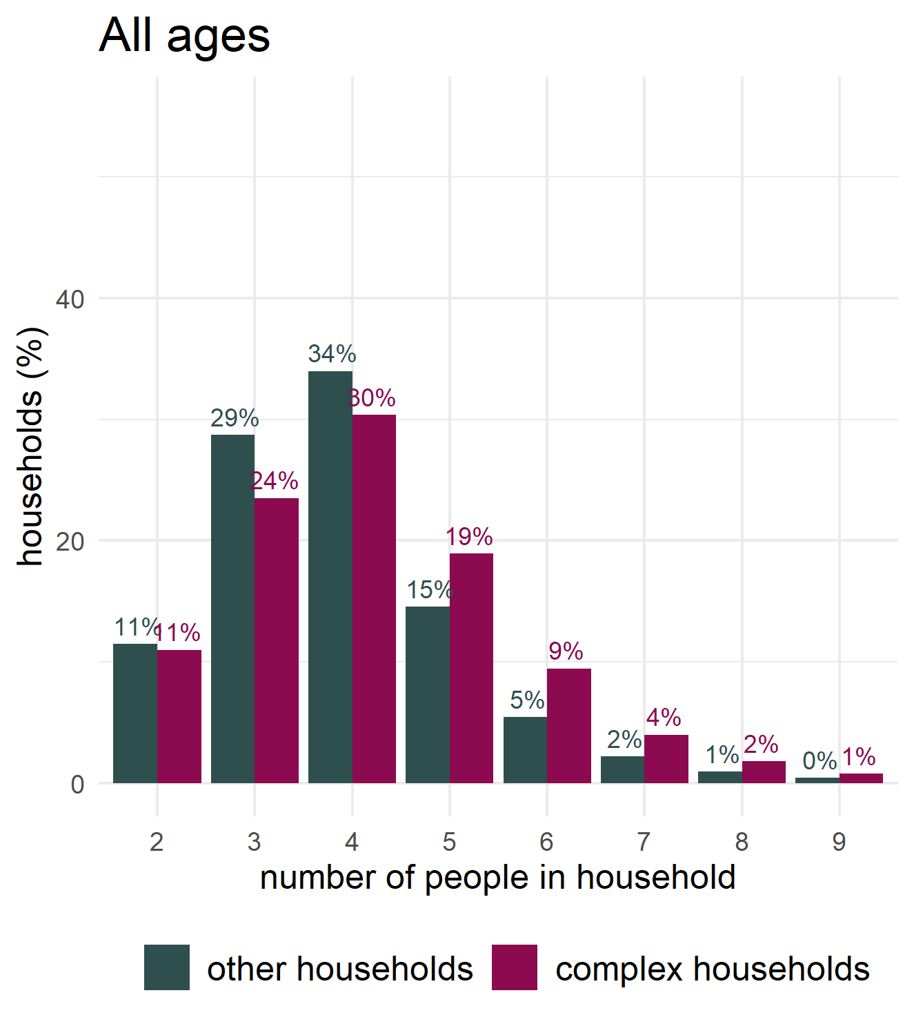
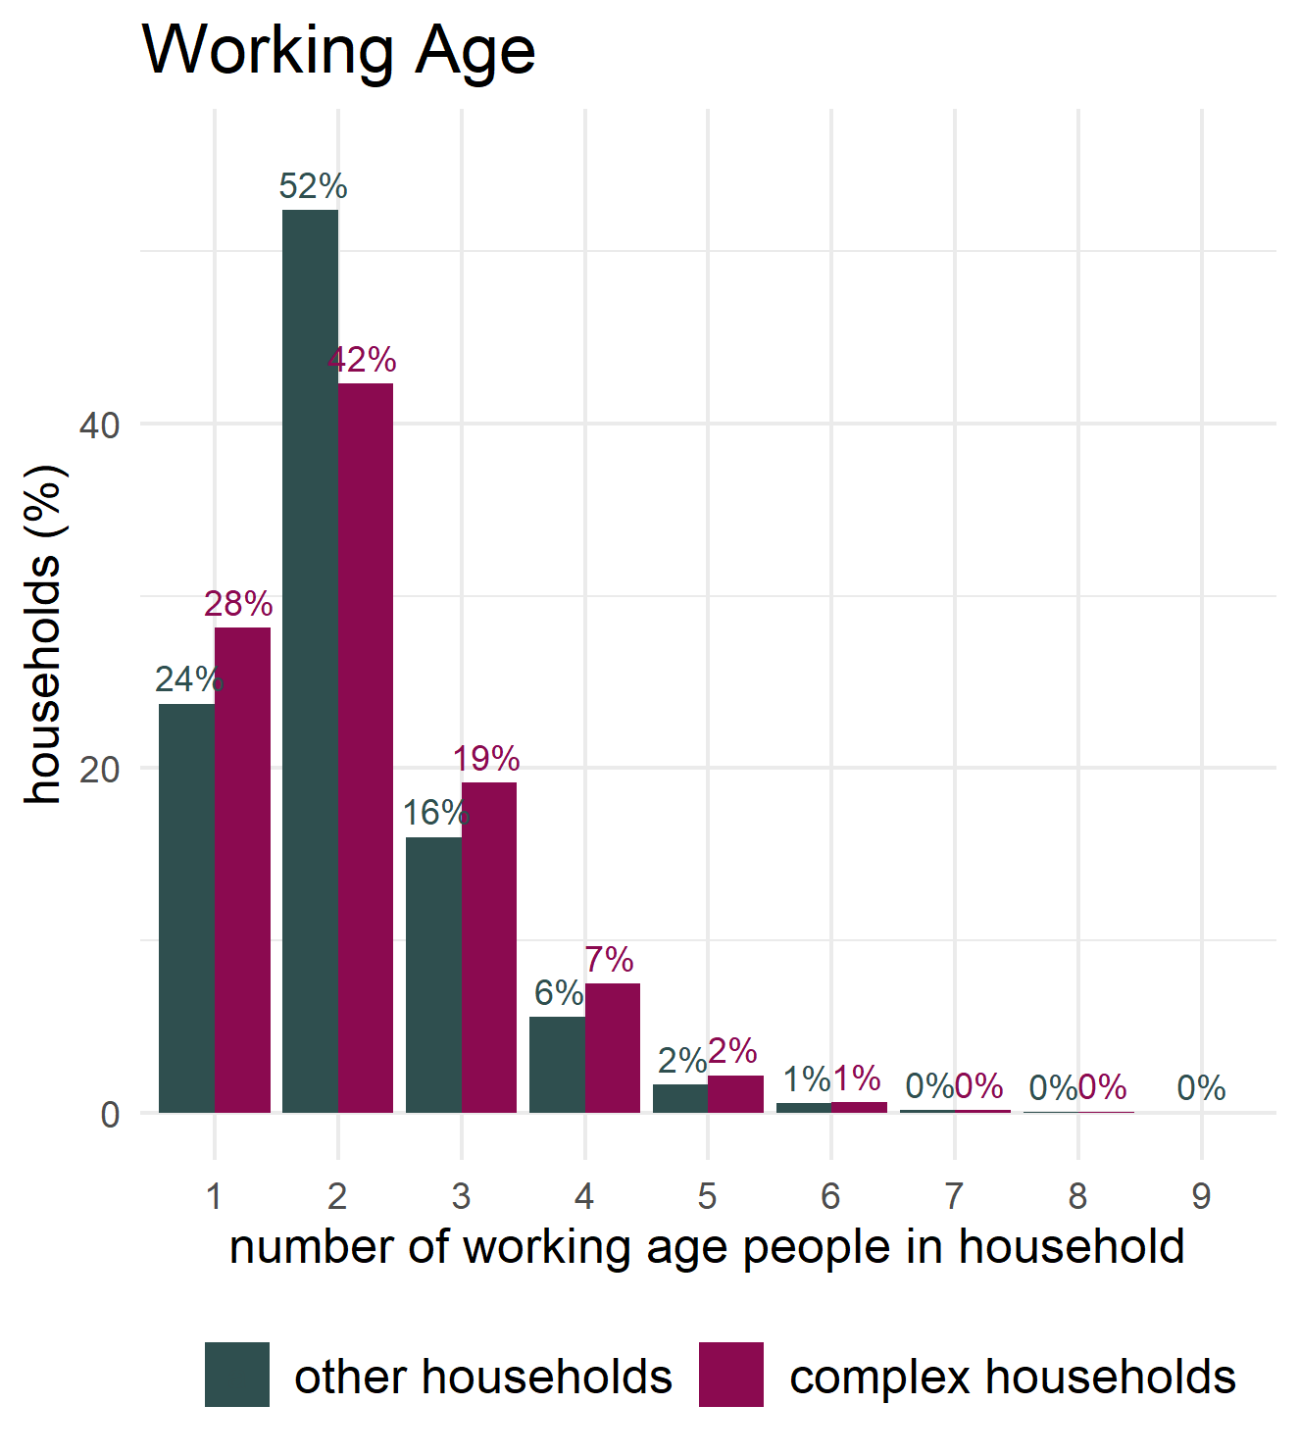
Number of people in households

Slide 7
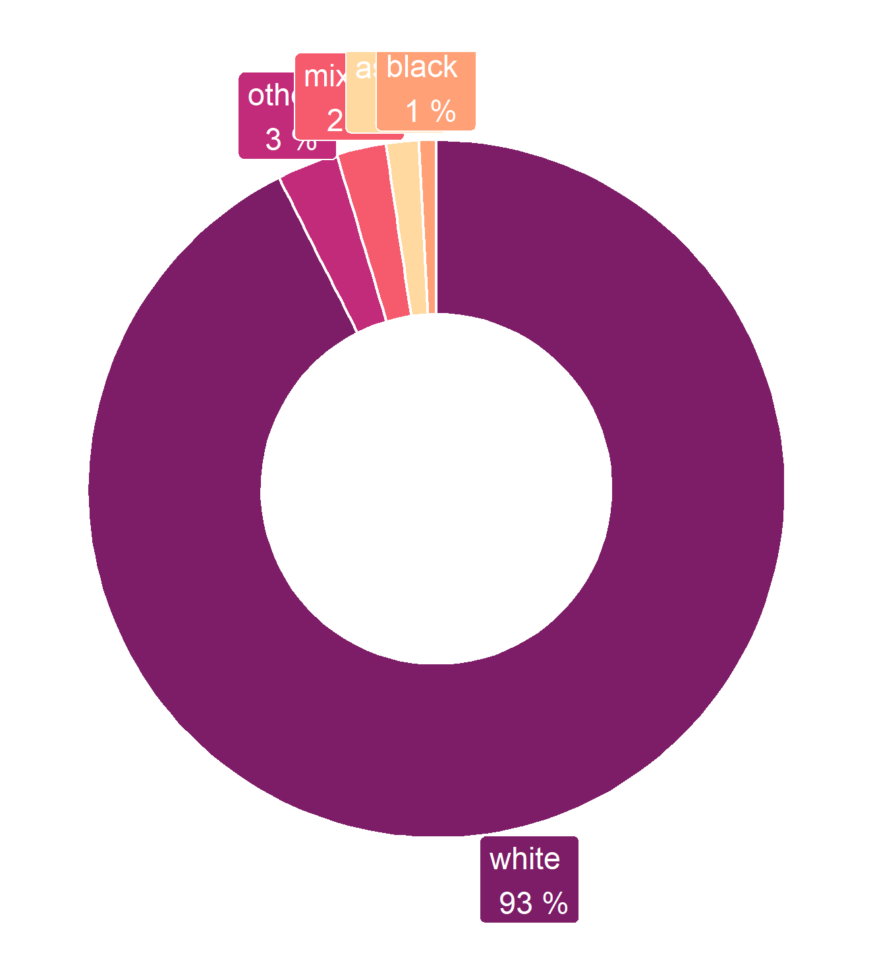
Ethnicity
Ethnicity | Other households | Complex households
asian | 3% | 2%
black | 1% | 1%
mixed | 3% | 2%
other | 4% | 3%
white | 89% | 93%

Slide 8
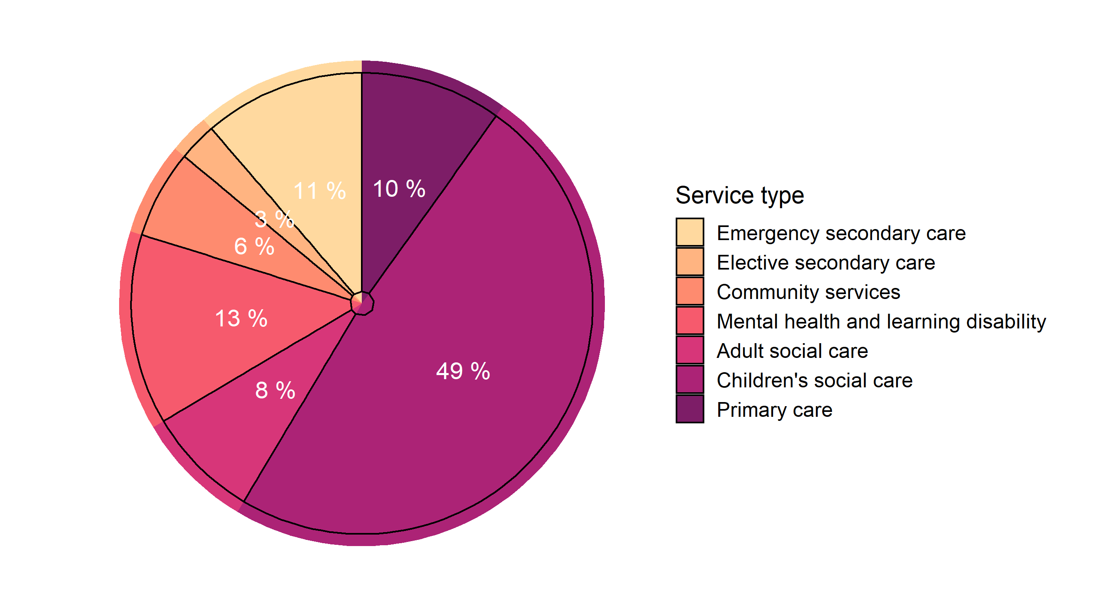
Service use - share of spend on complex households by service type

Slide 9
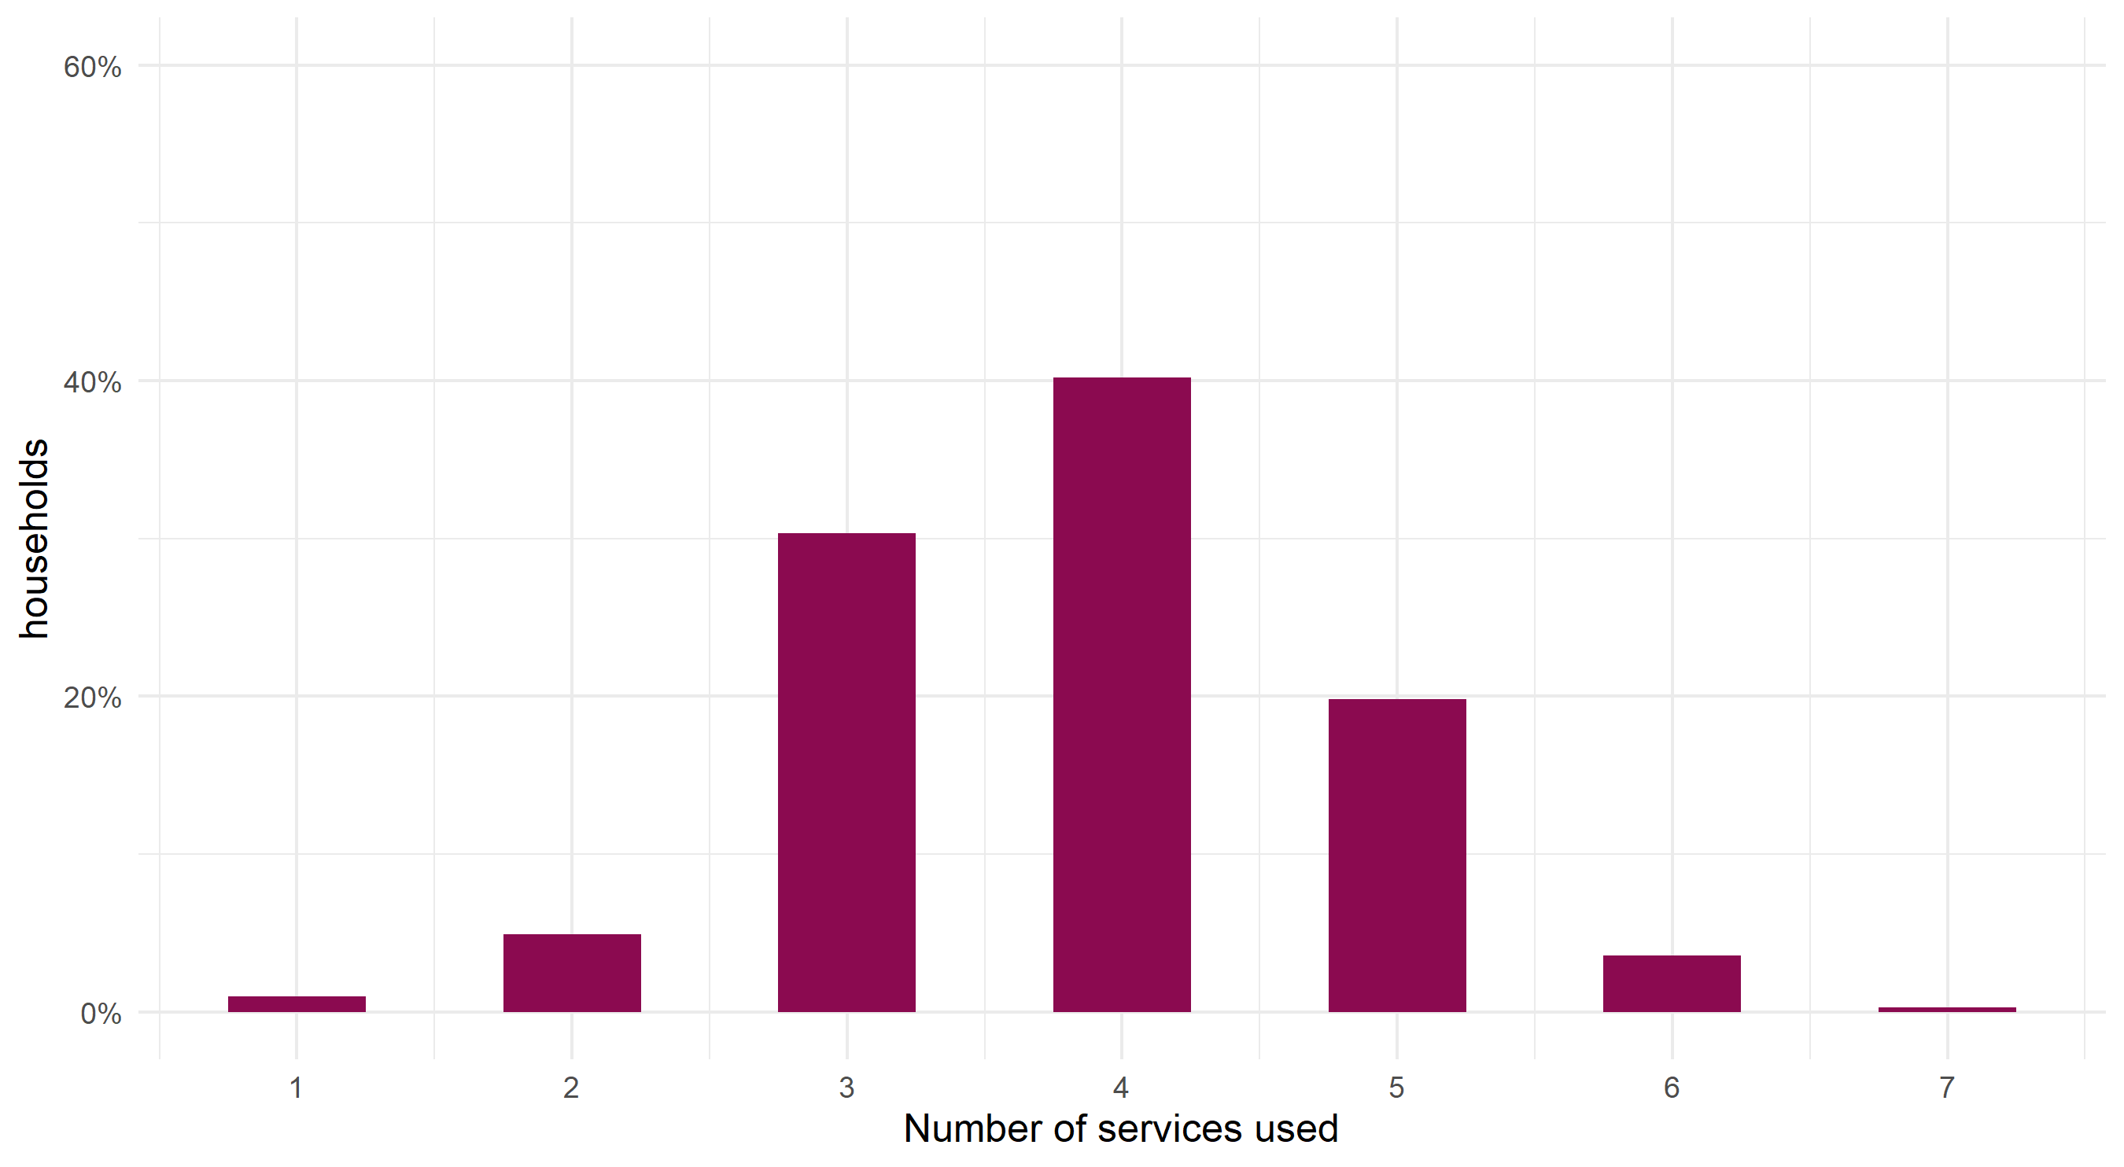
Service use - Number of services used by complex households

Slide 10
Annual use of health and care services by complex needs households (2021)
For every 100 adults, on average:
16 had 24 emergency admissions,
3 had 3 elective admissions,
32 had 58 A&E attendances,
8 had 19 referrals to mental health services,
10 had 92 contacts with mental health services,
For every 100 children, on average:
12 had 19 emergency admissions,
2 had 2 elective admissions,
34 had 61 A&E attendances,
20 had 40 referrals to mental health services,
23 had 196 contacts with mental health services,
54 had 631 contacts with community health services.
8 were looked after

Slide 11
Annual use of health and care services by complex needs households (2021)
Adults:
11265 emergency admissions,
1487 elective admissions,
27025 A&E attendances,
8902 referrals to mental health services,
43084 contacts with mental health services,
Children:
7536 emergency admissions,
774 elective admissions,
24295 A&E attendances,
16094 referrals to mental health services,
78446 contacts with mental health services,
252503 contacts with community health services.
3032 were looked after

Slide 12
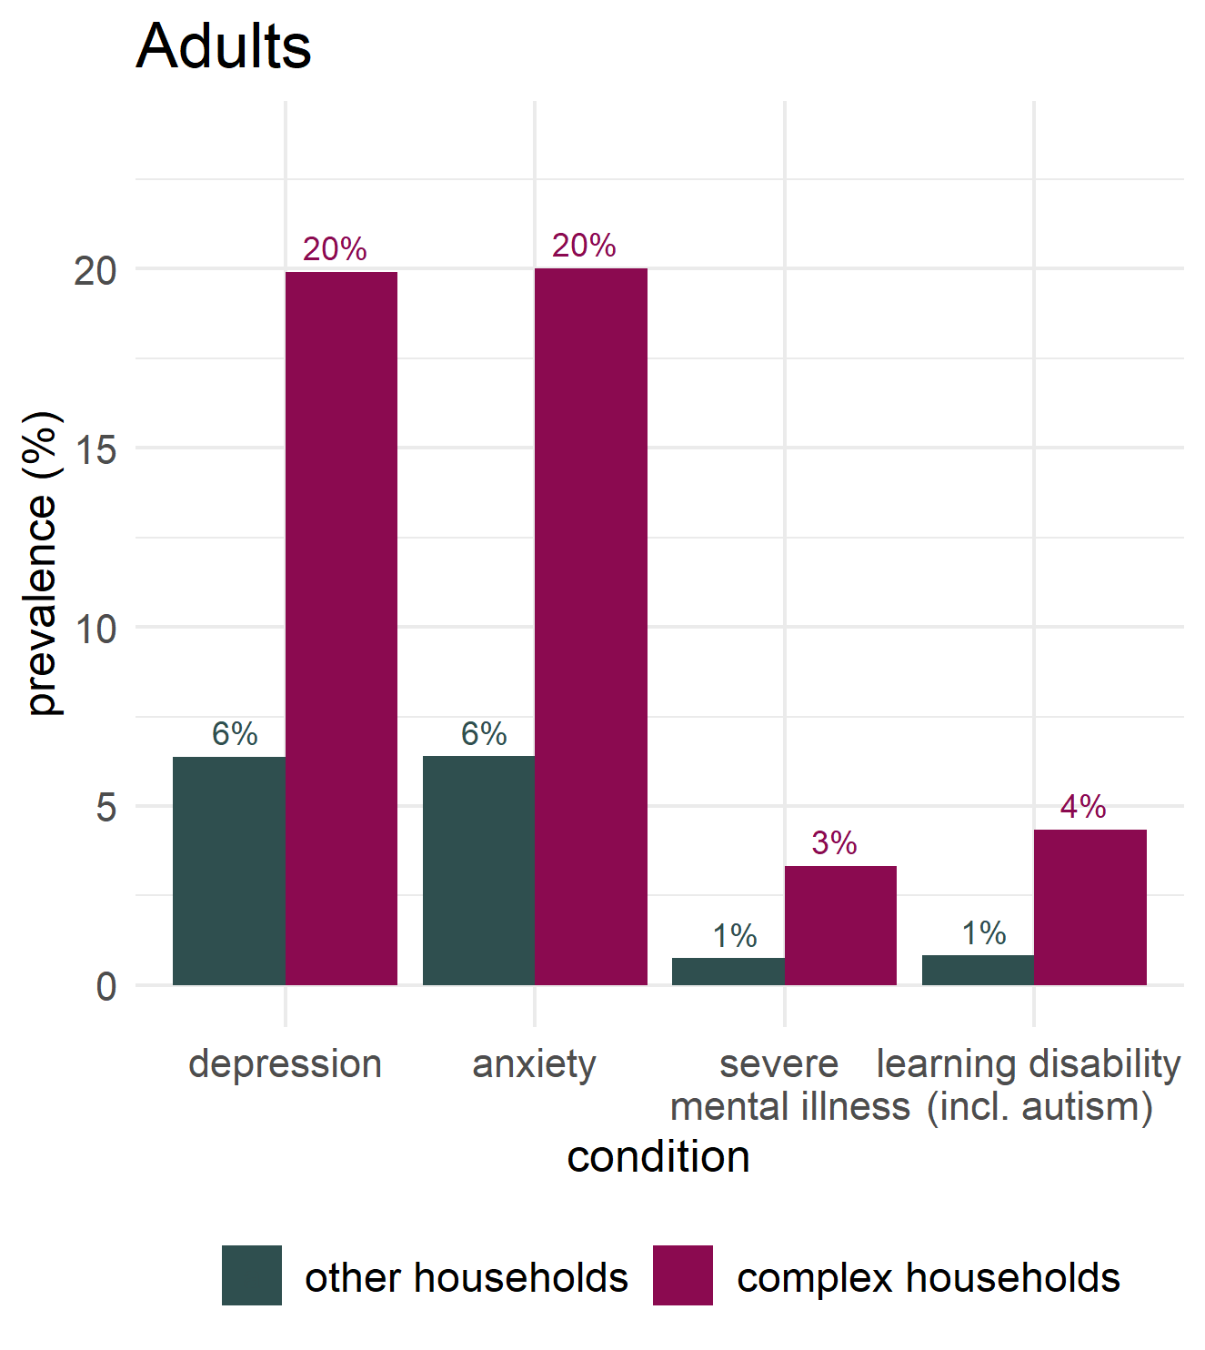
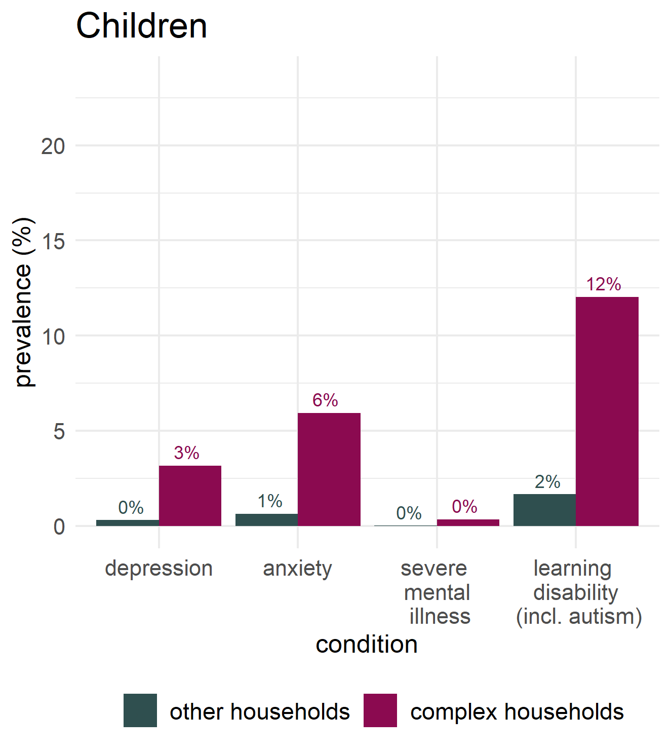
Mental health conditions and learning disabilities

Slide 13
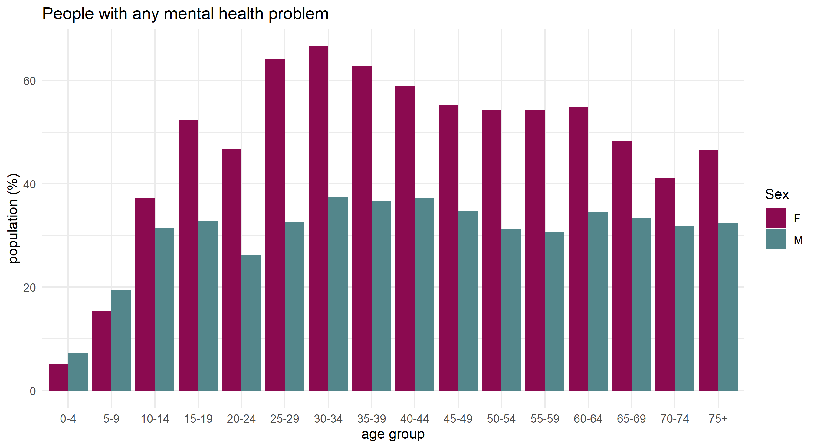
Age and gender of people with mental health problems in complex households

Slide 14
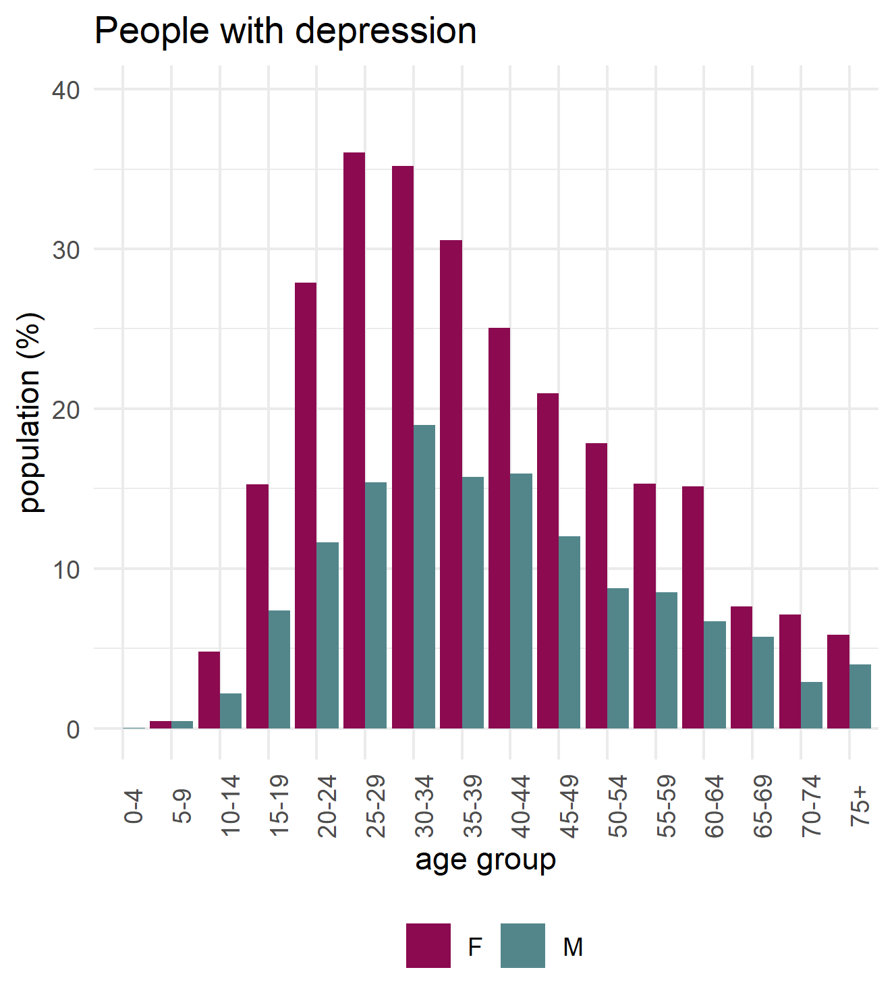
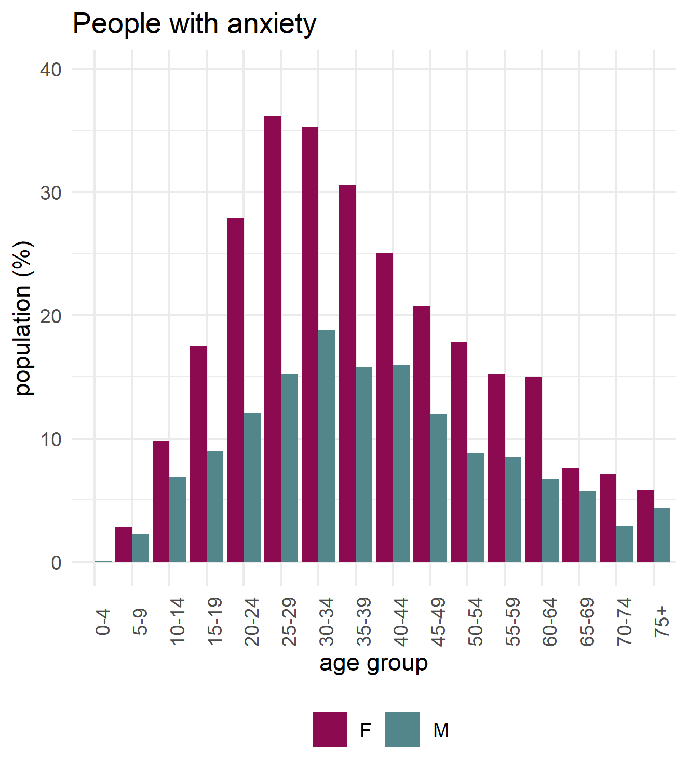
Depression and anxiety in complex households

Slide 15
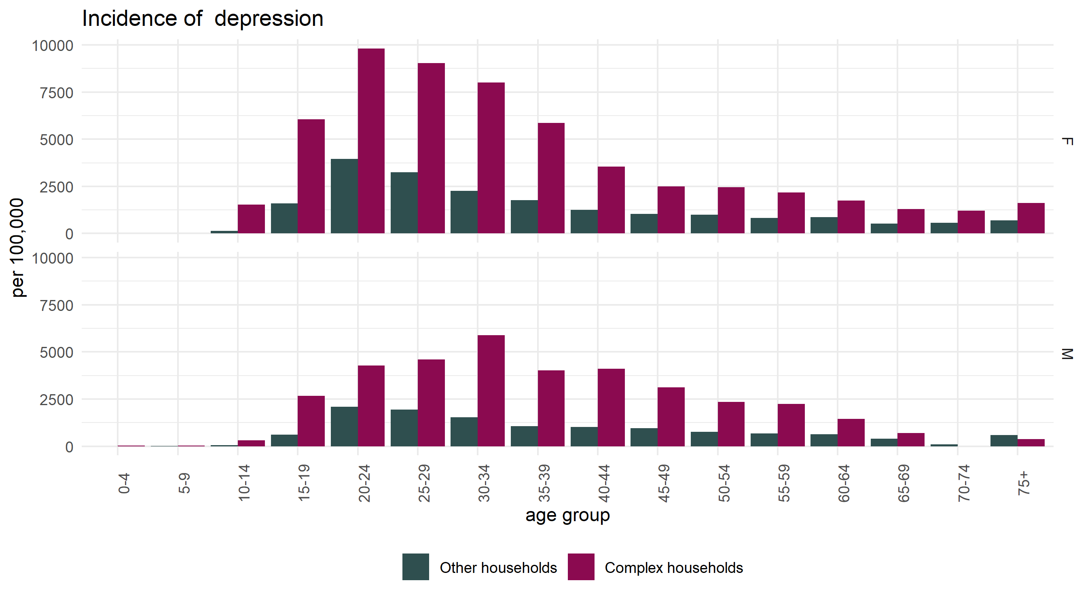
Incidence of depression in complex and other households

Slide 16
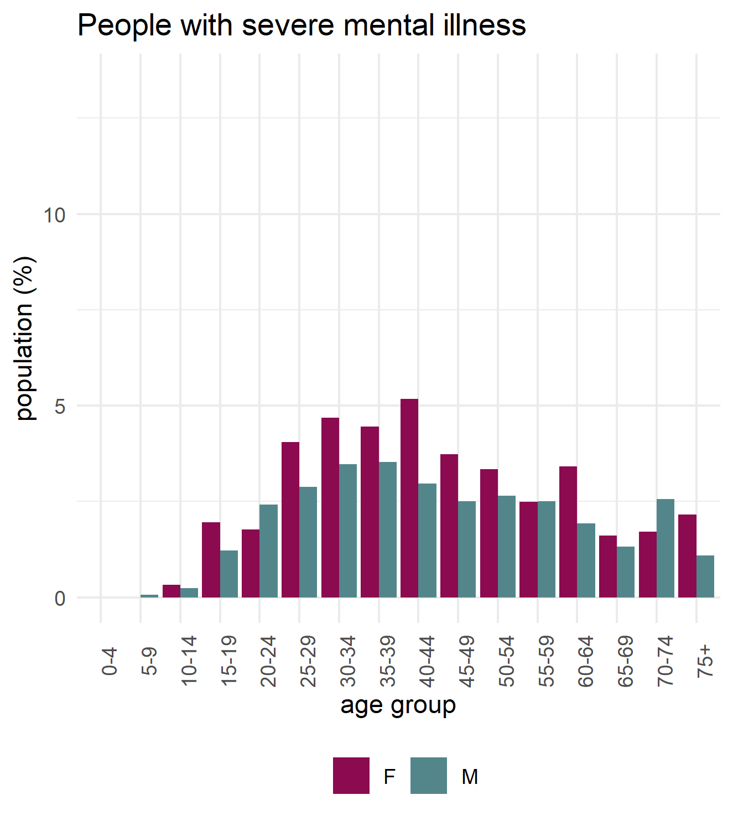
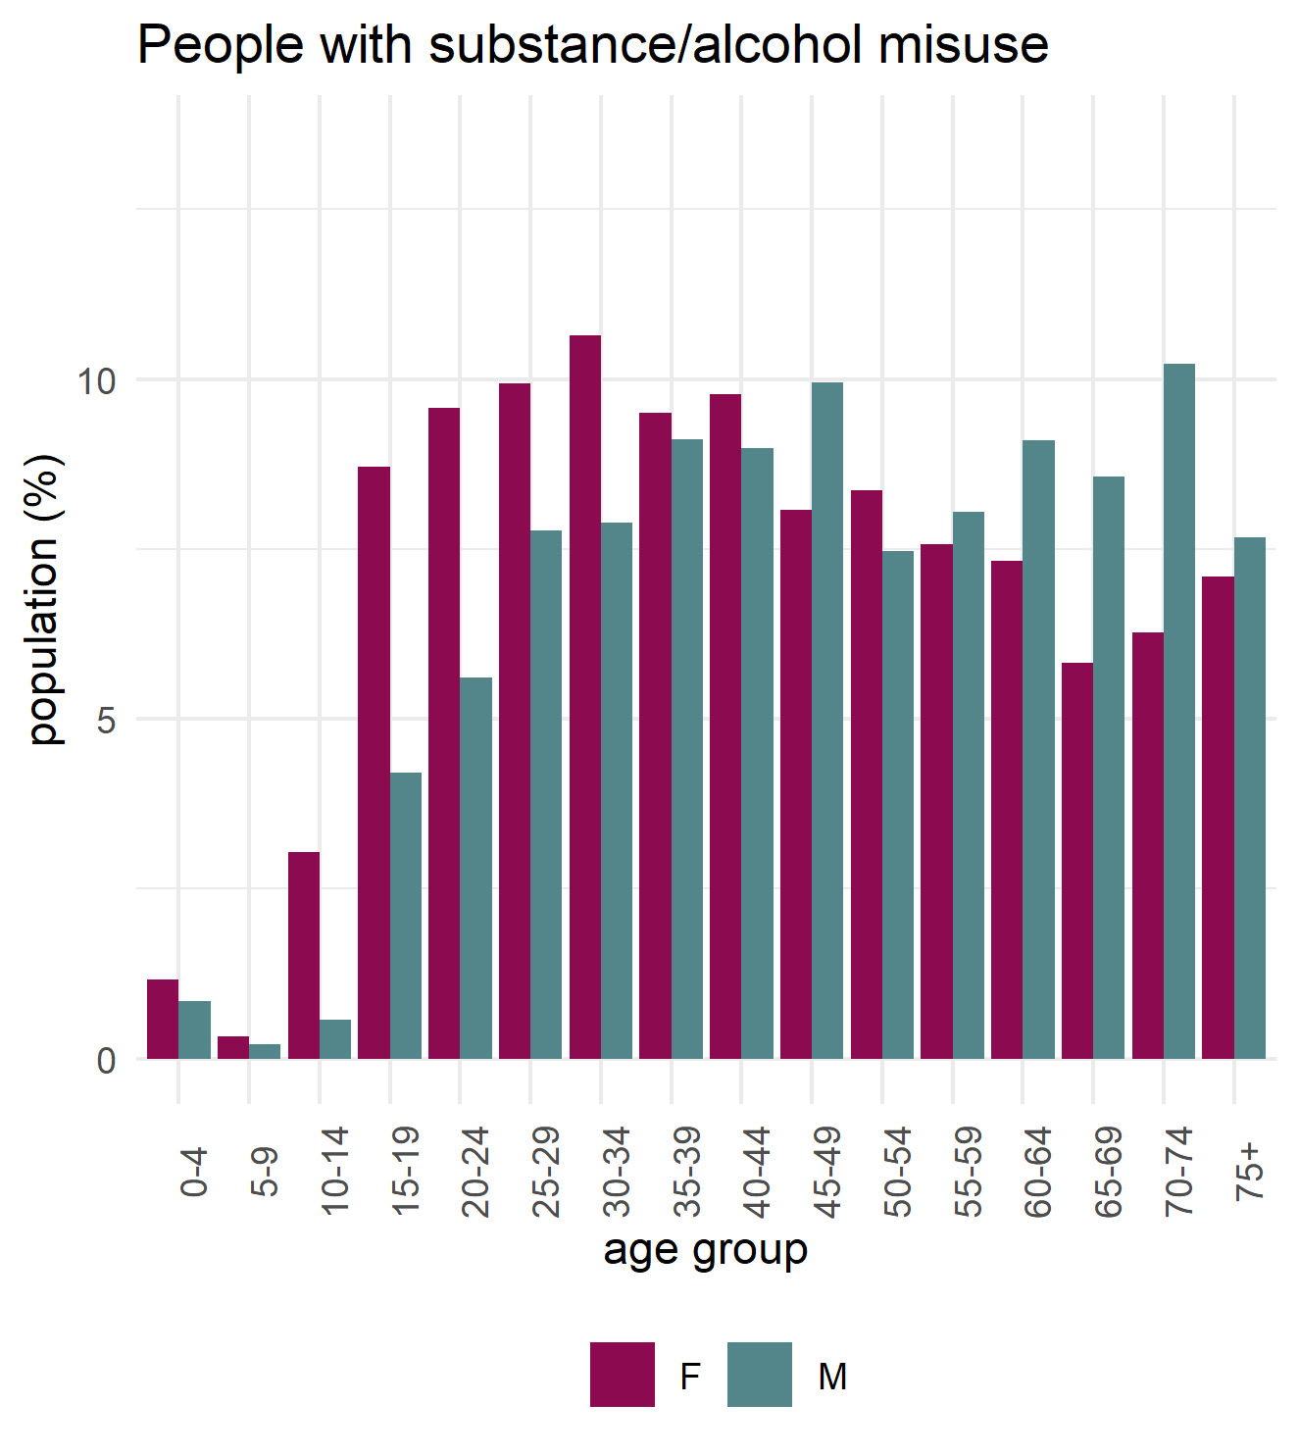
Severe mental illness and substance misuse complex households

Slide 17
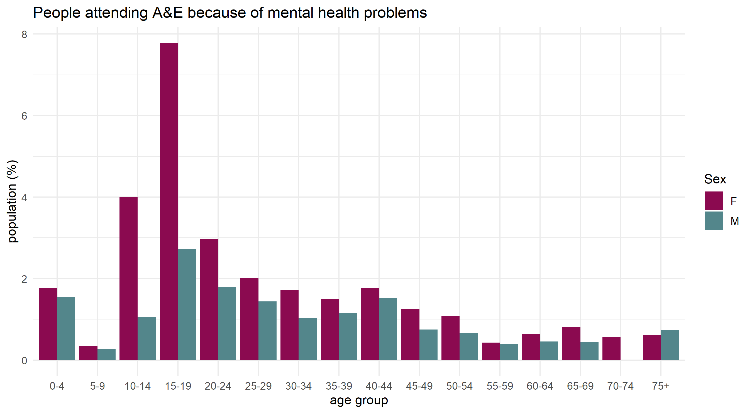
A&E attendances for mental health problems

Slide 18
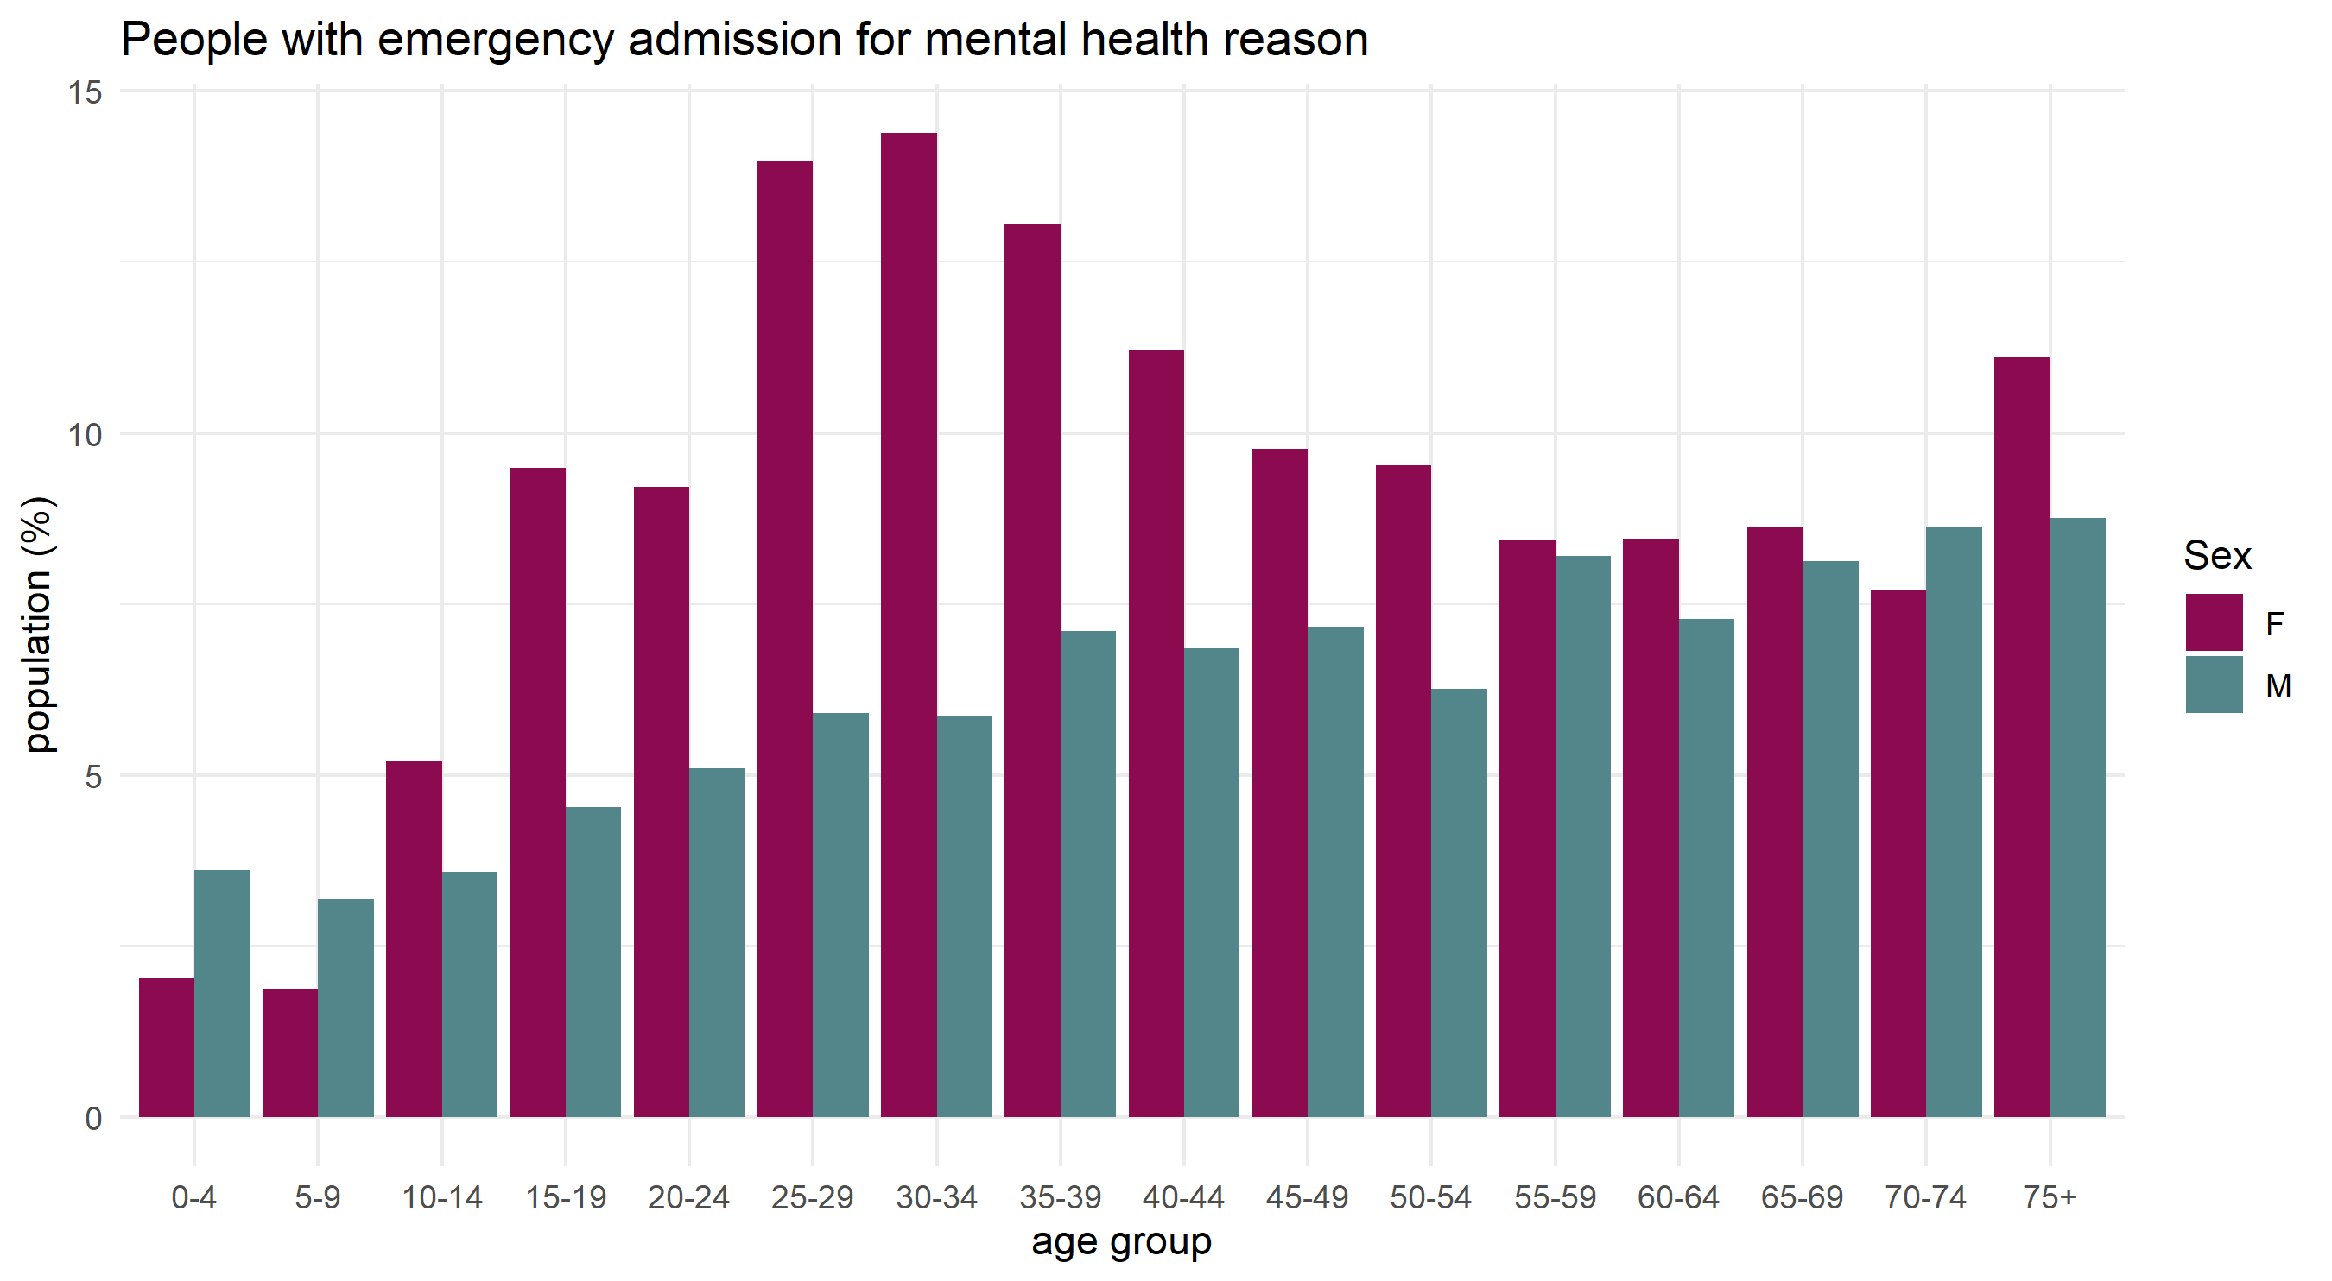
Emergency admissions for mental health problems

Slide 19
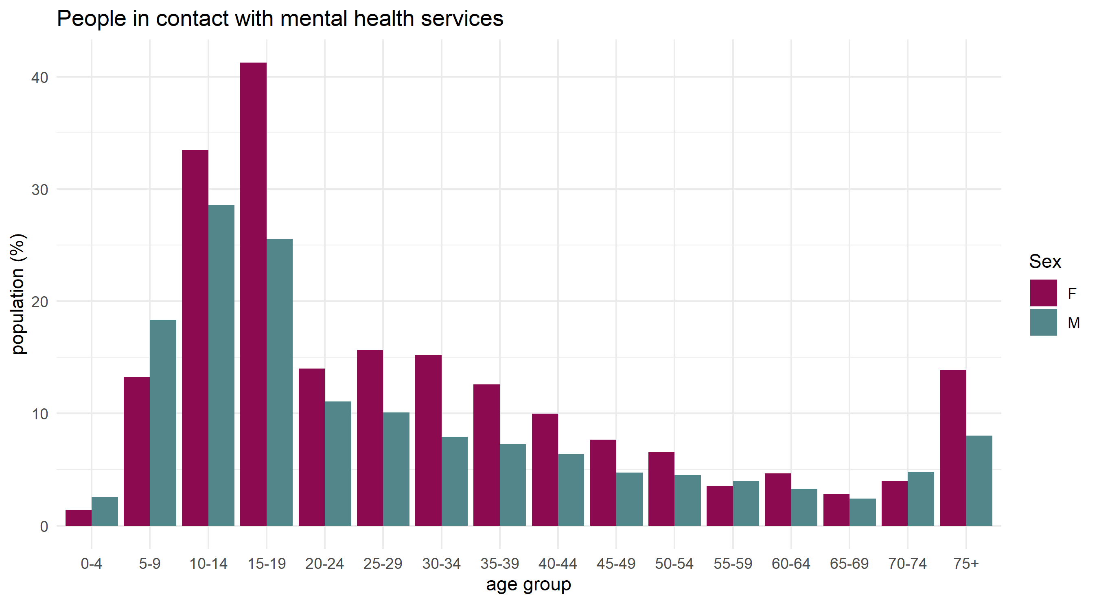
Use of community mental health services for mental health problems

Slide 20
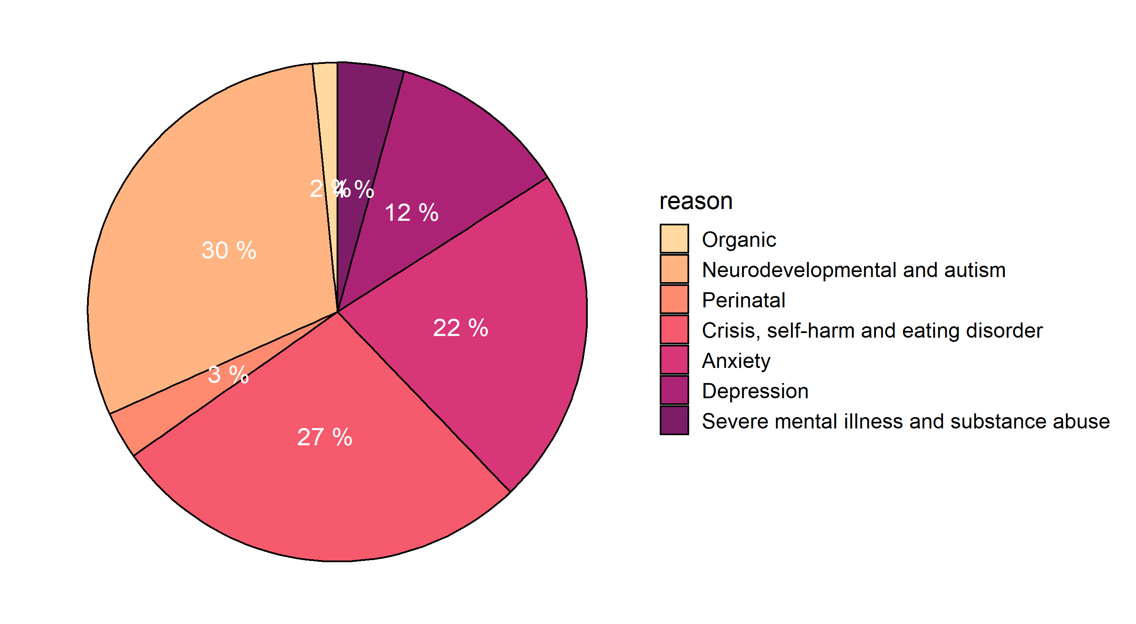
Reasons for use community mental health services by complex households (% contacts)

Slide 21
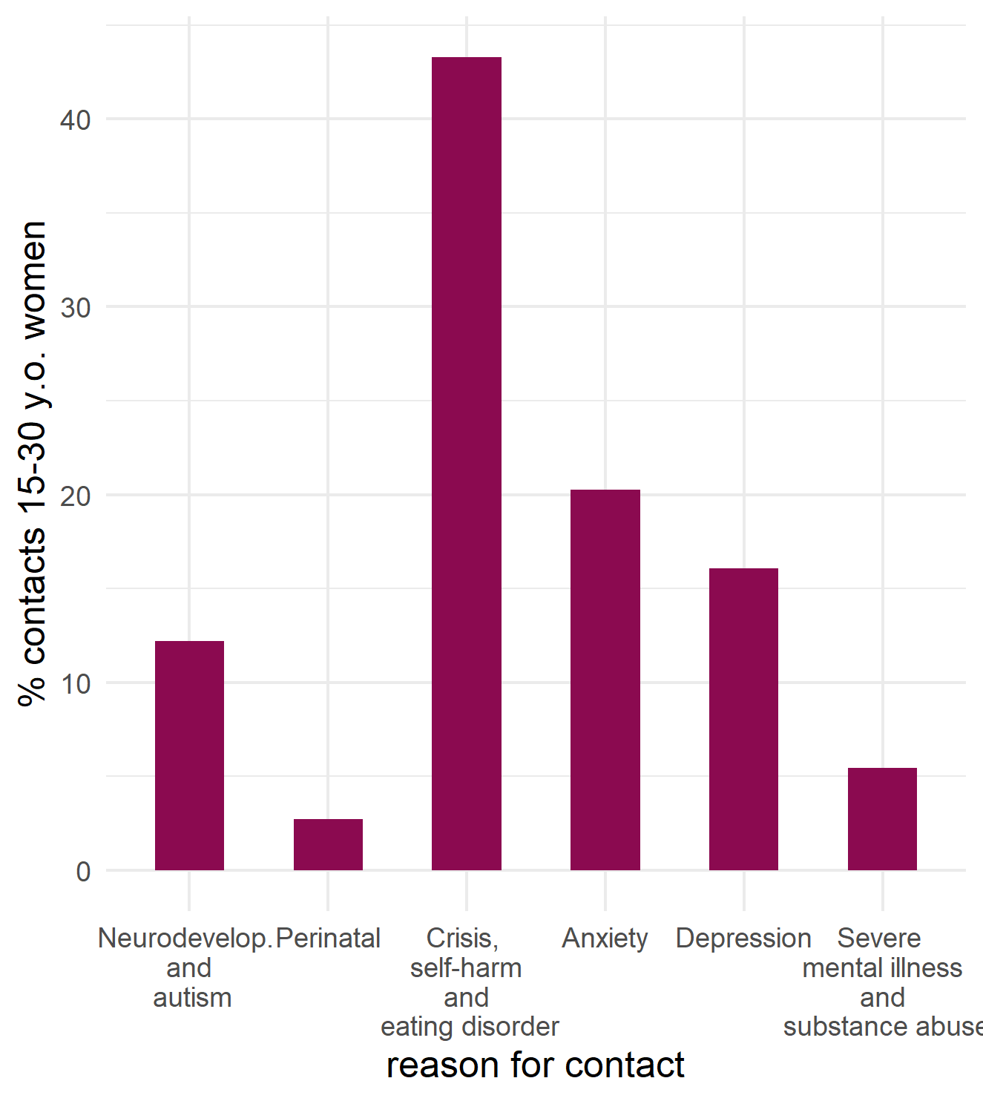
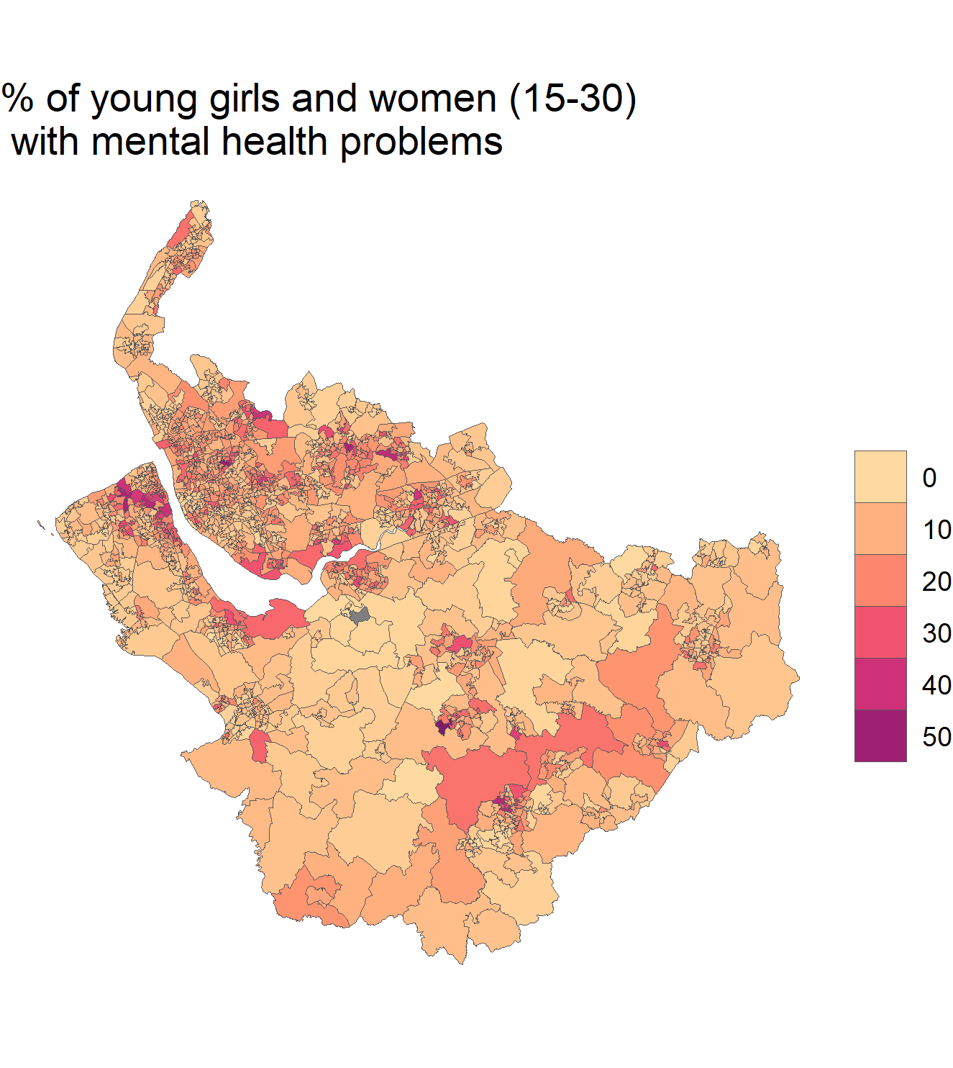
Mental health problems amongst 15-30 year-old women

Slide 22
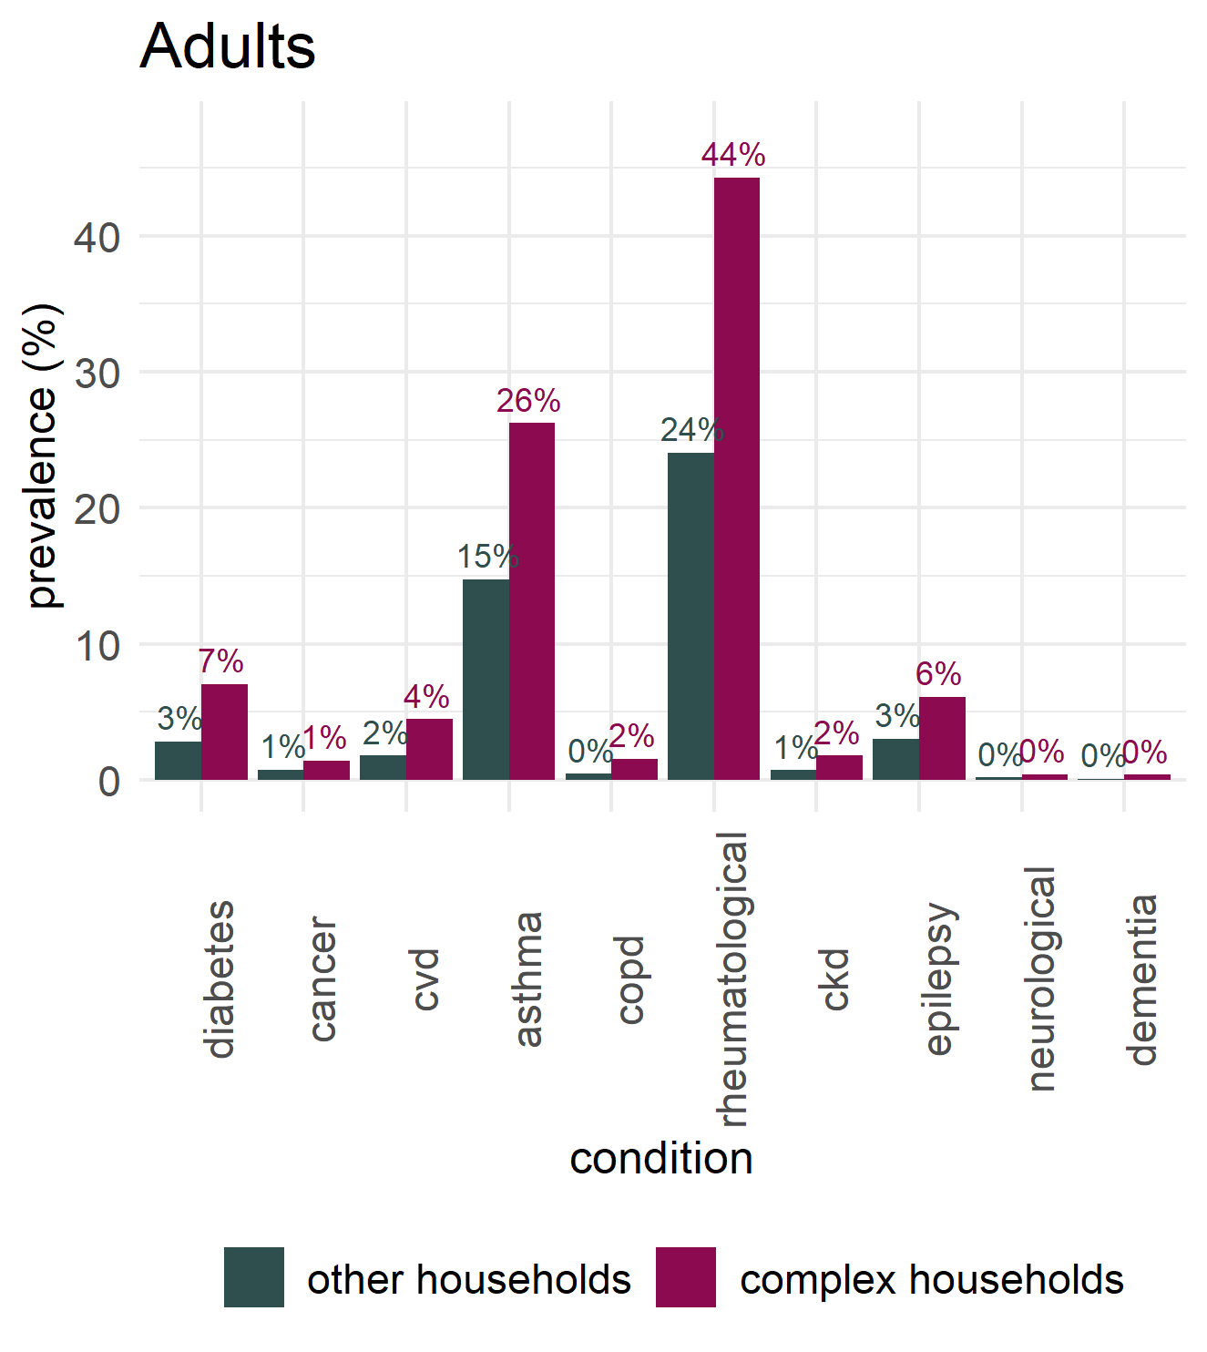
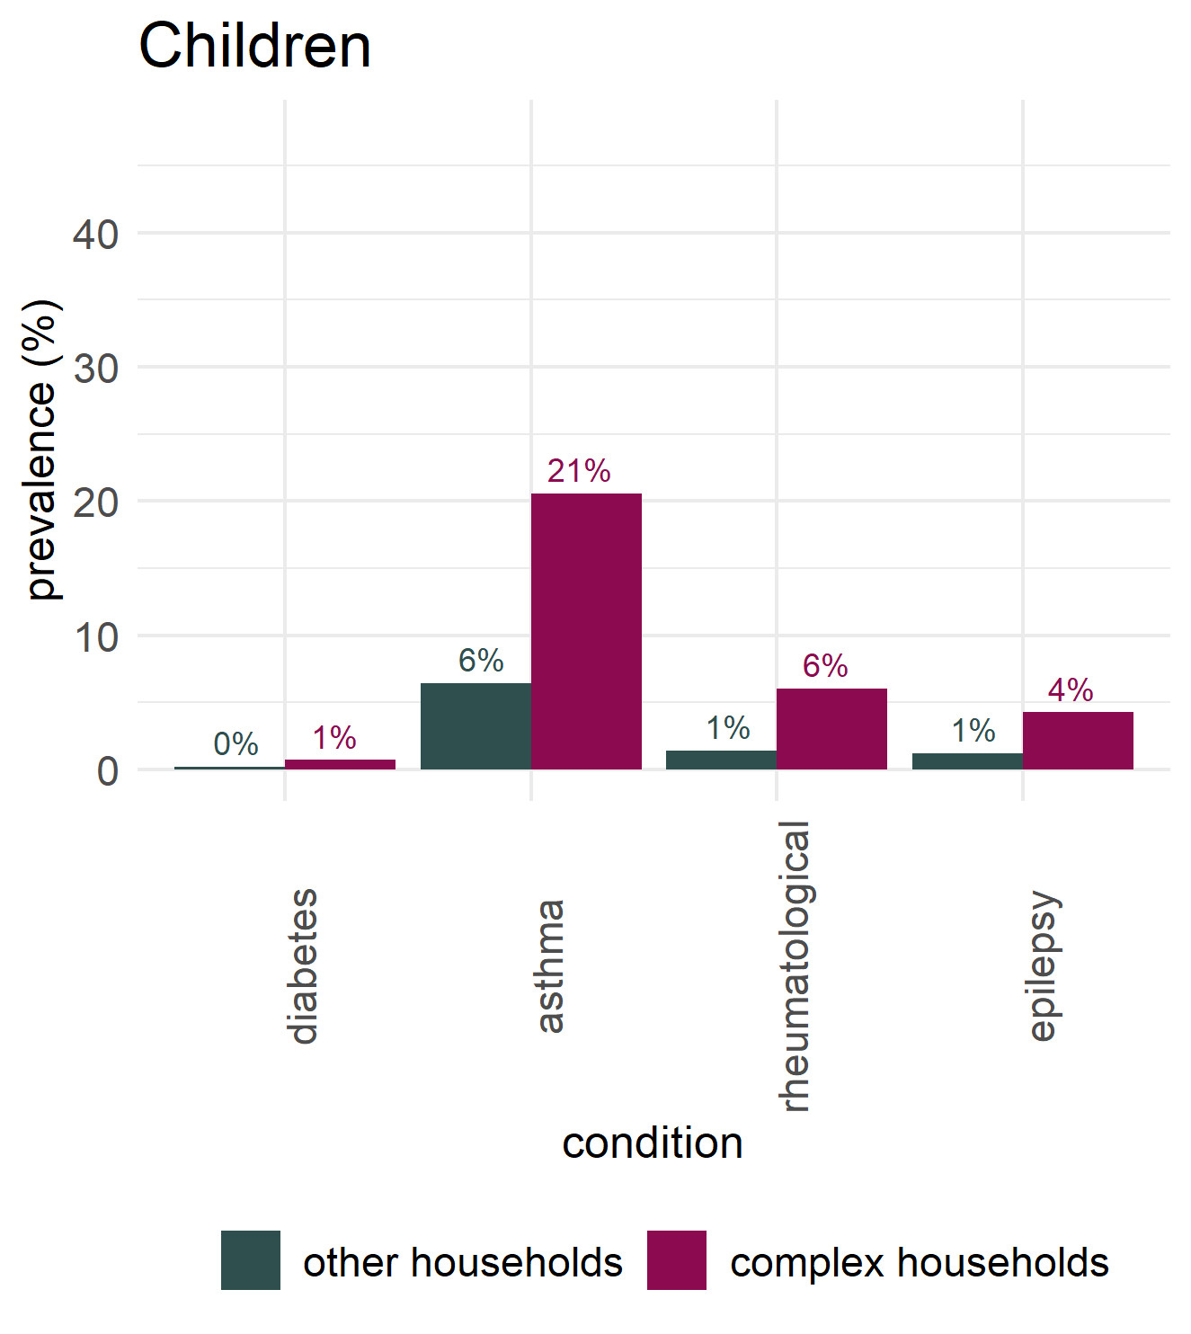
Physical health problems in complex households

Slide 23
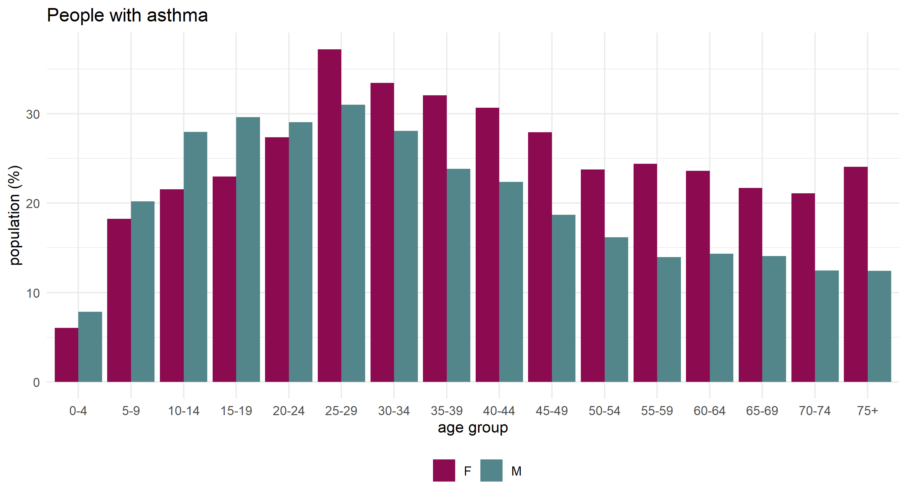
Asthma in complex households

Slide 24
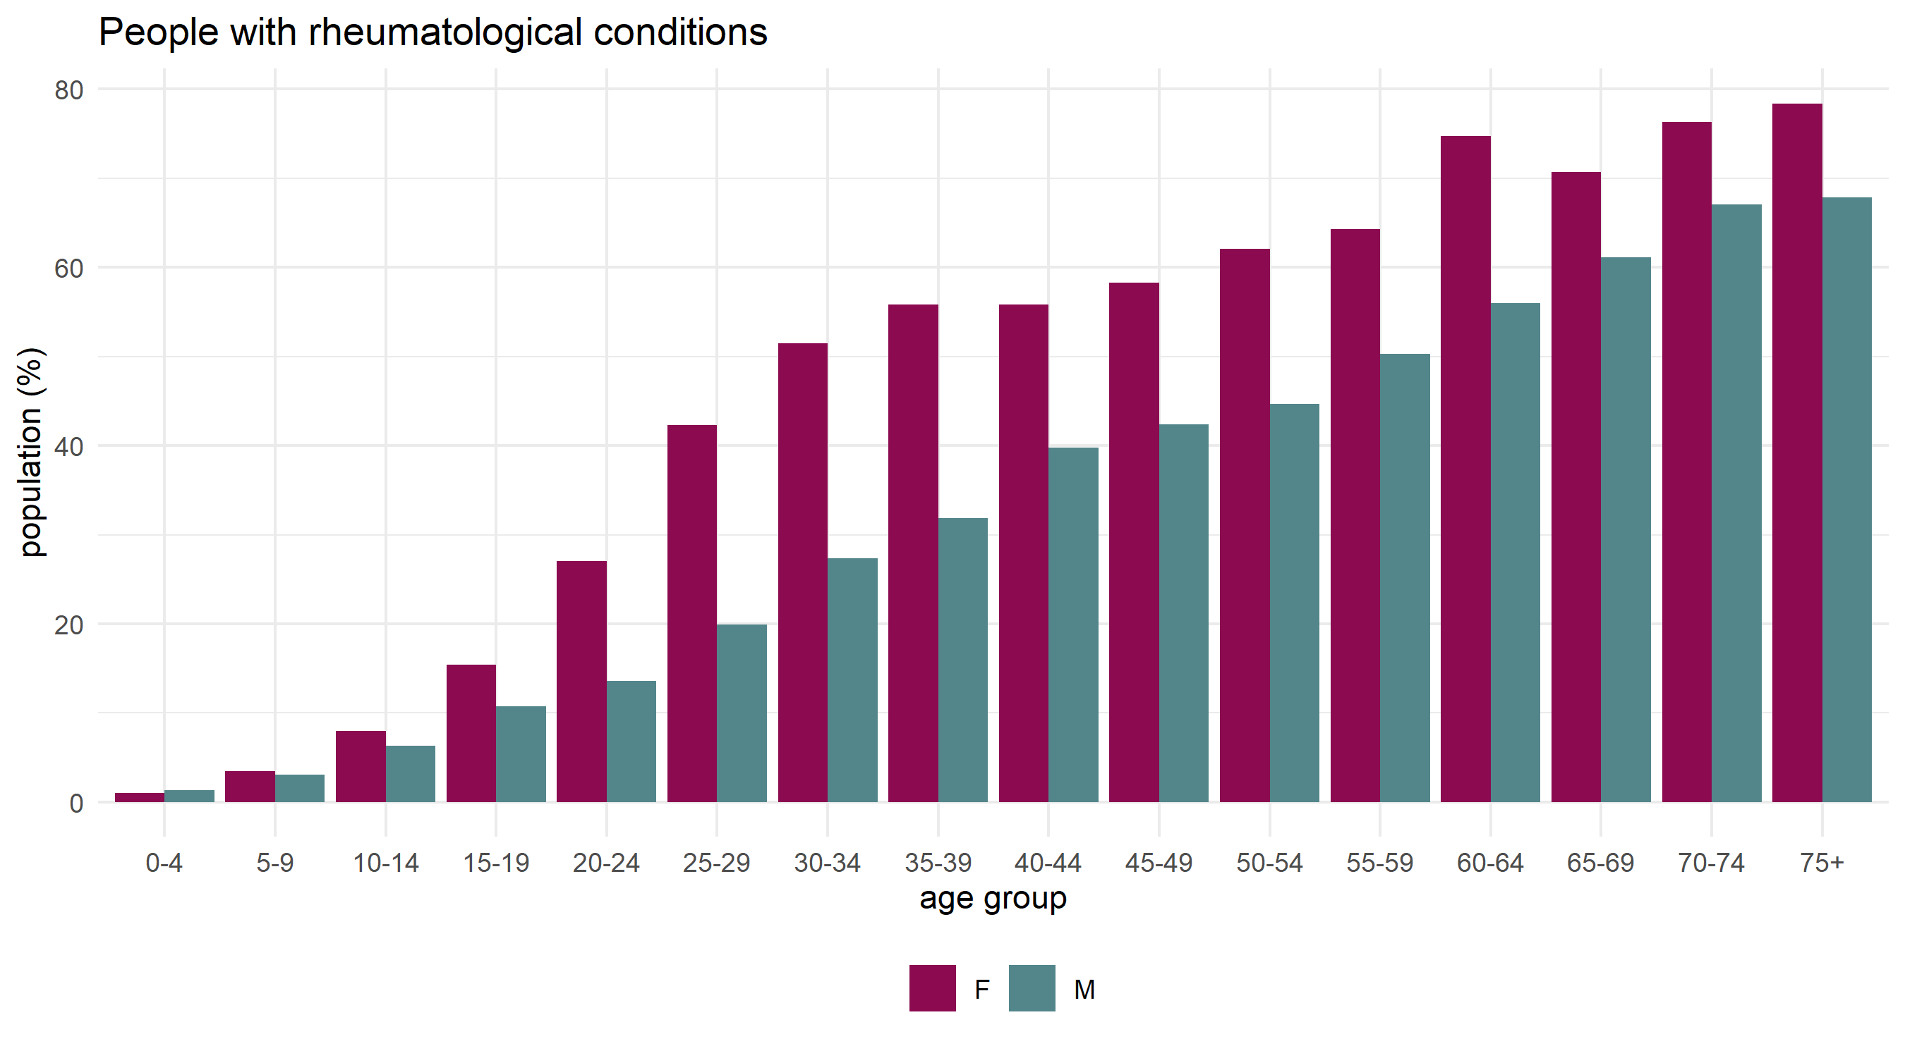
Rheumatological conditions in complex households

Slide 25
Methods
Included in the analysis are all individuals registered with a GP in Cheshire and Merseyside where their practice had an agreement to share their data with NHS Cheshire and Merseyside Integrated Care Board. This analysis used a pseudonymised version of the unique property reference number (UPRN), which was provided by NHD Digital Data Services for Commissioners Regional Office (DSCRO) of Arden and GEM. This analysis included only residential properties lying within the boundaries of Cheshire and Merseyside. The focus of the analysis was households with children. Thus, the definition of households was:
a set of individuals who live at the same residential address,
where at least 1 individual is a child aged between 0 and 16 years inclusive,
where the total number of residents at the address is less than 10, to exclude institutions and medium to large multiple occupancy residential properties.

Slide 26
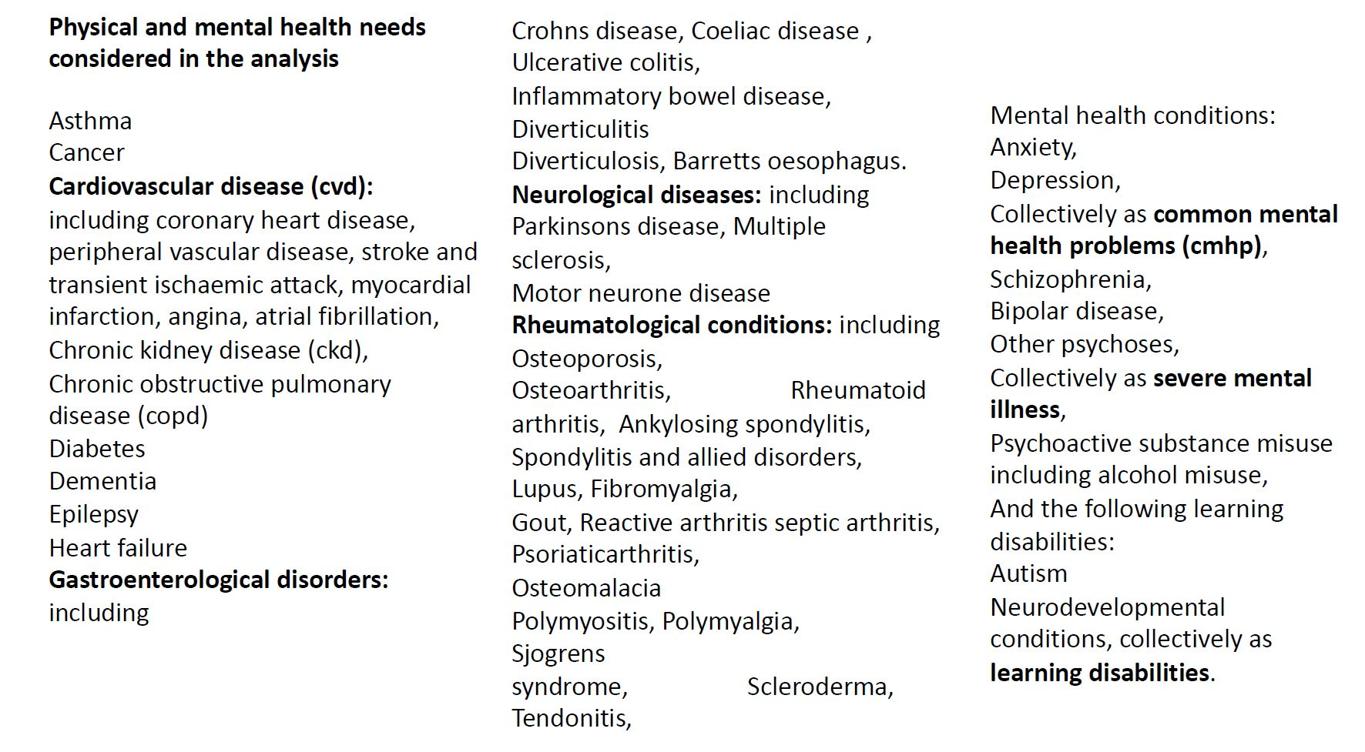

Slide 27
This work was supported by funding of the National Institute for Health and Social Care Research - NIHR - Public Policy Research Programme grant number 202428 - RESTORE: Research for Equitable sySTem respOnse and REcovery.
The views expressed in this publication are those of the authors and not necessarily those of the National Institute for Health and Social Care Research or the Department for Health and Social Care.

